Slide 1
Discriminative Semi-Supervised Generative Adversarial Network for Hyperspectral Anomaly Detection
Durham College
Oshawa
By.
Sharath K Prabhu
Notes:
Hello, I am Sharath Kumar from the department of Ai at Durham College, Canada. Today I will be presenting the research paper named Discriminative Semi-Supervised Generative Adversarial Network for Hyperspectral Anomaly Detection.

Slide 2
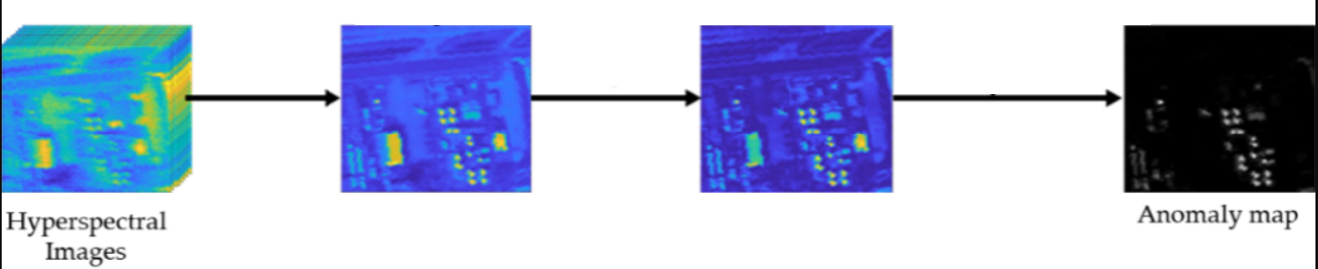






What is Hyperspectral Anomaly Detection?
Sources – https://www.mdpi.com
The process of extracting anomalies or differences the spectral features of images on processing the images at different levels.
Notes:
So, before we jump into the contents of the, let’s see what is Hyperspectral imaging?
Hyperspectral imaging is a process of collecting and processing information from across the whole electromagnetic spectrum enabling a deeper and different perspectives of vision at different wavelengths of light. The goal of hyperspectral imaging is to obtain the spectrum for each pixel in the image with a purpose of finding objects, identifying materials, or detecting processes or changes viewed from same angles at different points of time.
So, to achieve this, we use Generative modeling which is an unsupervised learning task in machine learning that involves automatically discovering and learning the regularities or patterns in input data in such a way that the model can be used to generate or output newer examples that plausibly could have been drawn from the original dataset.
Hence, to achieve the objective of Hyperspectral Imaging, an unsupervised binary classification model called as the semi-supervised Generative Adversarial Network or (SGANs) are used which predicts the changes or differences in the spectral features of the images or the backgrounds by processing the images at various levels, whose spectral features are unknown.

Slide 3
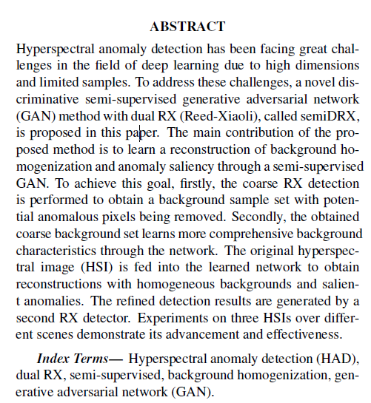
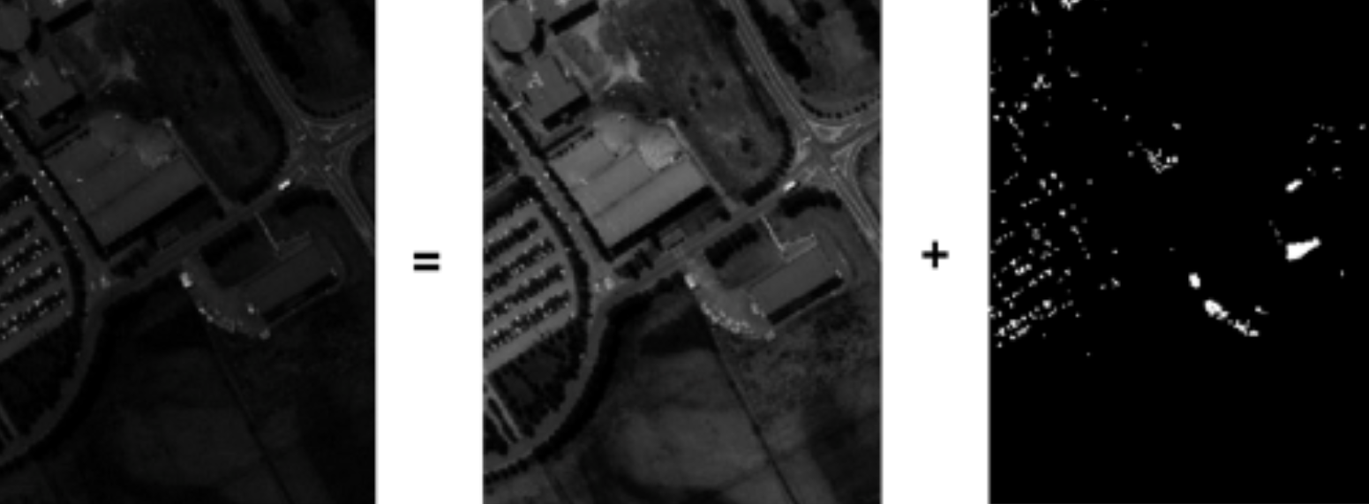
Abstract
Source - https://www.spiedigitallibrary.org/
Notes:
Now, going through the abstract of this paper, the focus of the research paper is to determine a method to reconstruct a background homogeneous image and silencing the anomalies through a semi-supervised GAN model.
To achieve this, first, we use a dual Reed-Xiaoli Detector (RXD) model. At first, the first RXD model takes in the image as the input. Then the image is subjected to what is called as Target Extraction where spectrally distinct features from the captured image are pronounced from the image’s background as shown in the picture. Once the distinct features or the anomalies are detected, the pixels containing these features are removed by the RXD model. For this process to be effective, the anomalous targets must be sufficiently small and relative to the background.
Once this process is done, the image is fed to the GAN network that learn the image and its background characteristics. After the process of learning is done by the network, the Original Hyperspectral Image is fed to the network to obtain the reconstructions with homogenous backgrounds and salient anomalies. Then the output of the network is fed to the second RXD to refine the detection.
So, to study the effectiveness and precisions of the model, the paper demonstrates using 3 Hyperspectral Images over the advancements.

Slide 4
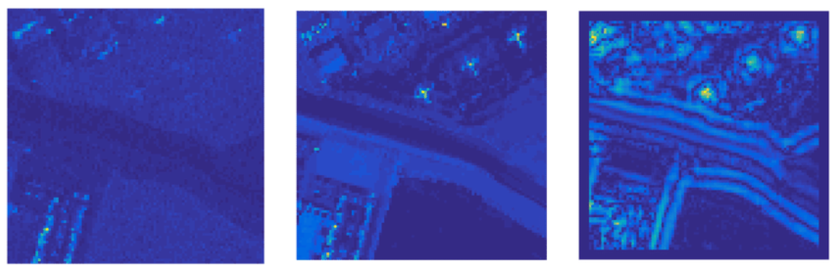
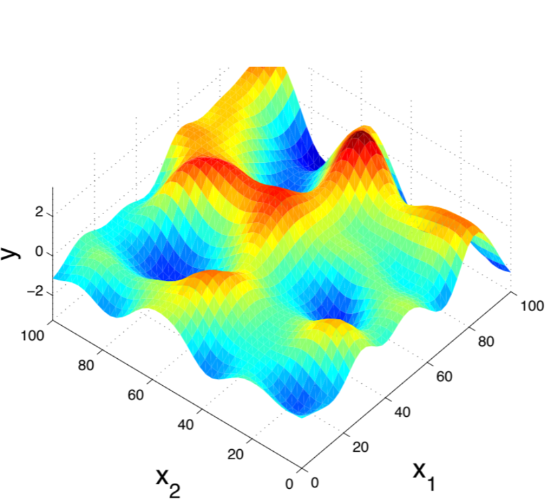
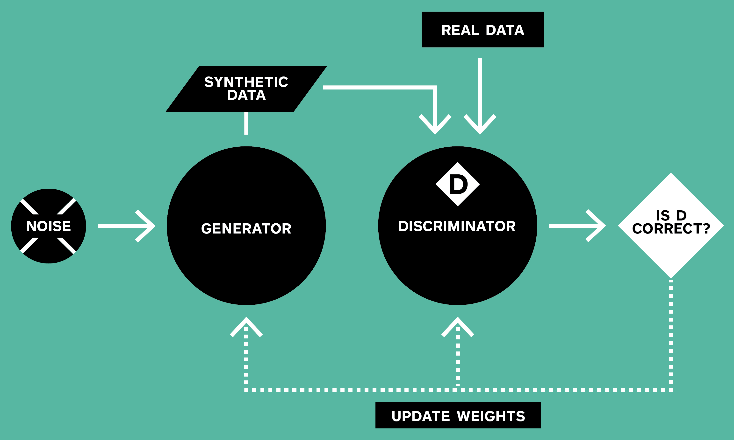
Introduction
Source - https://www.researchgate.net/
Source - https://thegradient.pub/
Source - https://developer.squareup.com/
Notes:
Now, before introducing to the main content, let’s see what are Hyperspectral images. HSIs contain hundreds of nearly continuous spectral bands that can provide rich spectral information, which facilitates anomaly detection in civilian and military applications. The Hyperspectral Anomaly Detection is dedicated to identify the pixels with distinctive spectral information compared to the surrounding pixel.^{[1]}
The most widely used H.A.D processes can be split into 3 categories – The 1st is RX model, which stands for Reed-Xiaoli, a statistical-based algorithm; 2nd is LSMAD model, an acronym for Low-Rank Decomposition in Hyperspectral Anomaly Detection and the 3rd is deep anomaly detection – the D.A.D model.
The RX method assumes that the background obeys a multivariate Gaussian distribution. But with the actual complex land cover distribution of the HSIs, it becomes difficult to estimate with such an ideal assumption.^{[2]}
Then we have the LSMAD method. This method aims to set the background apart from anomalies through matrix decomposition where a hyperspectral image is decomposed into two subspaces: a low rank dimensionality matrix representation for the image background, and a high rank dimensionality matrix representation for image anomalies. However, both these techniques cannot achieve the best separation due to shallow exploration and straightforward information.^{[3]}
The DAD method, with its ability to learn deeper with its nonlinear characteristics, especially using the GANs^{[4]}, it is capable to learn the deeper structures and characters of the image. The use of dual RX models with the discriminative semi-supervised GANs, the influence of atmospheric disturbances; imperfect equipment; availability and accuracy of labels for HSIs and manual identification and label marking can be mitigated. This use of predicted coarse labeled data can produce dominant performance over unsupervised learning as well.^{[5]}

Slide 5
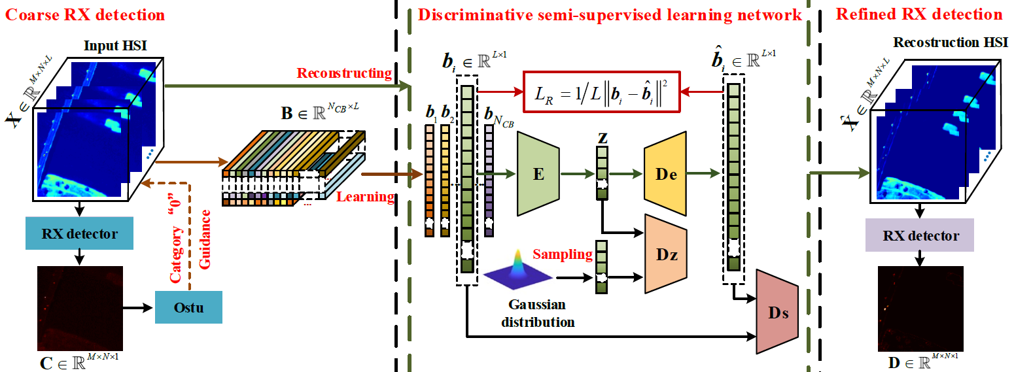
Methodology
Source - https://ieeexplore.ieee.org/abstract/document/9323688
Coarse RX Detection
Discriminative Semi-Supervised Learning GAN Network
Refined RX Detection
Notes:
Coming to the methodology, this paper a consists of three major parts. As we can see in the slide, the first part is Coarse RX Detector, 2nd being Discriminative Semi-Supervised Learning GAN Network and third, the Refined RX Detector.

Slide 6
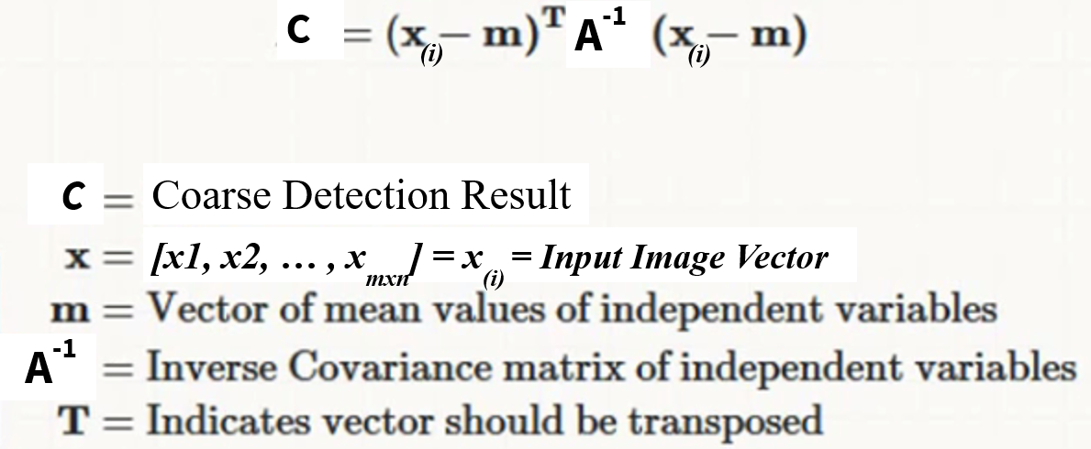
I. Coarse RX Detection
Mahalanobis Distance Formula
Source - https://ieeexplore.ieee.org/abstract/document/9323688
Notes:
So, the first step is to perform the Coarse RX detection. So, what is done here!?
So, as we can see from the slide, the input HSI image is fed to the RX Detector model. The model implements a Mahal-nobis distance-based RX detector to find the multivariate outliers, that indicate unusual combinations of variables.
As we can see in the formula, let’s assume that the lower-case ‘x’ as a 3-dimensional input image vector having dimensions - M x N x L- with L being the number of samples. This image vector ‘x’ is subtracted with the arithmetic mean vector, the lower case ‘m’, which is of the dimension L x 1. The inverse covariance matrix – A-Inverse - with the dimensions – M x N x 1 - is a measure of the magnitude of variation between the independent variables. So, applying this formulation, the model produces an output C, that is the Coarse Detection Result.
The outcome from the RX Detector is fed to an Ostu Thresholder model. An Ostu thresholder is a model that iterates through all the possible threshold pixel values and calculates a measure of spread for the pixel levels, each side of the threshold, that either fall in foreground or background. Its aim to find the threshold value where the sum of foreground and background spreads is at its minimum. It then labels the pixel values 0 and 1. So, all the foreground pixel values with labels 1 will be discarded and the pixel values with labels 0 are selected as a coarse background pixels set, which is named as vector B in the output. This B vector of dimension N subscript cb cross L consists of all the values from b1 till the total size of b including all the samples L, as shown in the figure.

Slide 7
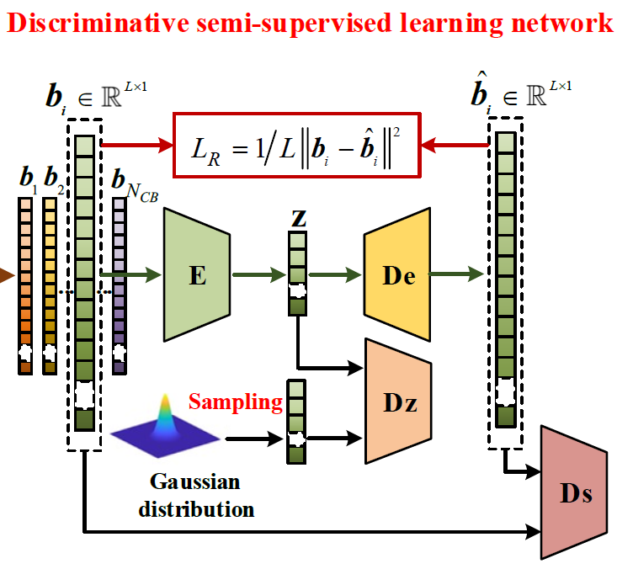
II. (a) Discriminative Semi-Supervised GAN
Source - https://ieeexplore.ieee.org/abstract/document/9323688
Notes:
So, the output of RX Detector is fed to a Generative Adversarial Neural Network (GAN). Now what is a GAN?
A GAN in simple words is a machine learning model in which a combination of two neural networks compete to become more accurate in their predictions.
A GAN mainly consists of a generator and a discriminator that participate in a zero-sum game. The generator creates samples like the real data to confuse the discriminator, while the discriminator tries to identify the generator’s trick to find the real ones. This process is continued over and over to making the model more and more robust with the newer data that generators keeps creating.
In the experiment, due to the imbalance of GAN and the need for reconstruction, an auto-encoder (AE) is selected to construct GAN. That is, the Auto Encoder consists of an encoder
and a decoder that intends to minimize the variation between the input and output data to reconstruct the input image.
Here, a GAN is designed to fit into the HSI characteristics with limited samples in order to extract more discriminative information. Only a HSI can be used in each learning process, and each pixel of HSI is treated as a sample.
So, as seen on the slide, the discriminative network consists of an encoder E, a decoder De, a latent discriminator Dz, and a spectral discriminator Ds.
The result of the network consists of two adversarial losses and one reconstruction losses. Now, let's understand these losses mathematically.

Slide 8
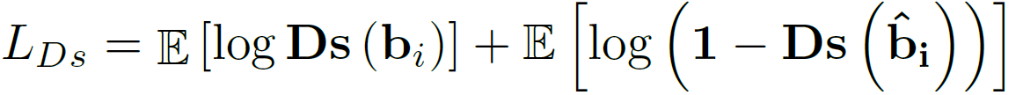
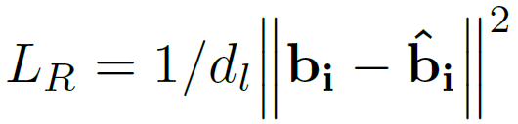
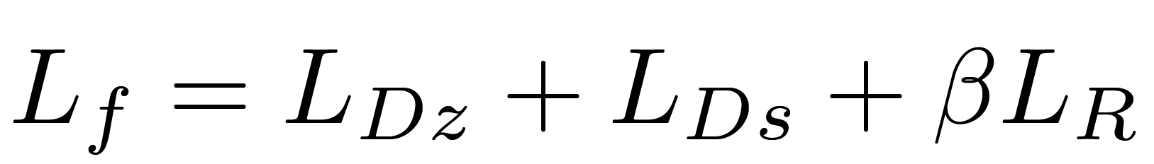
III. Loss Function Evaluation
Latent Discriminator Loss L_{DZ}
Spectral Discriminator Loss L_{DS}
Reconstruction Loss L_{R}
Overall Loss
Source - https://ieeexplore.ieee.org/abstract/document/9323688
Notes:
So, basically GANS try to replicate a probability distribution. In a GAN, the generator can only affect the probability distribution of the fake data. So, in the loss function, we make the generator to focus on minimizing the loss function and the discriminator to maximize it.
From the model, the GAN contributes to loss production. They are the Latent Discriminator Loss, Spectral Discriminator Loss and the Reconstruction Loss.
Now, considering the RXs assumption of the Hyperspectral Anomaly Detection dataset following a multivariate Gaussian Distribution, the latent discriminator is added in between the Encoder E and the decoder De to force the encoder to follow a given multivariate Gaussian distribution.
In the adversarial loss function of the Latent Discriminator’s Loss, the log of probability estimation of the latent discriminator (Dz), given by log(Dz), determines if that real data generated by the generator is real. And multiplying with the ‘eta’ of (O, i) forces all the values to vary in terms of Gaussian Distribution. Similarly, the log of 1 subtracted by the probability estimation of the latent discriminator (Dz) determines if the fake data is real. In the end, the variable E counts the expected value over all real data for the first term and the fake data for the second term.
Similarly, the Spectral discriminator Ds is imposed to match the output of decoder De with the distribution of B. Hence, the same functioning takes place in the adversarial loss function for the Spectral Discriminator’s Loss.
And yet finally, the reconstruction loss Dr is performed by a mean squared method where 1/dl is the spectral dimensionality of the input space. The beta variable is the weight factor which is set to 10 on empirical methods.
The model then gives a reconstructed output X cap which is background homogenized, it’s discriminability being enhanced, and anomalies being silenced. Further the output X cap is given as an input to the second RX Detector for refining.

Slide 9
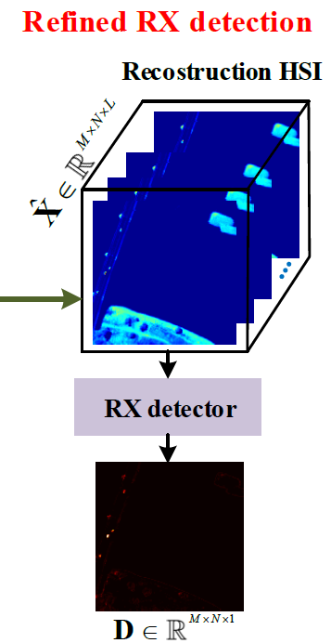
III. Redefined RX Detection
Mahalanobis distance-based RX detector
D
Source - https://ieeexplore.ieee.org/abstract/document/9323688
Notes:
In the last step of refinement, the input X cap is given as an input to the second RX detector to perform the refined detection on X cap. Since there is more discriminative information in X cap than X, the anomalies detected by the RX detector this time are clearer with less background interference.
The input format for X cap is similar to the Coarse RX Detector. Hence the same Mahal-nobis distance formulation is applied to the X cap which will take the place of the lower-case x for all the input samples i. The output D is the refined detection result of the dimension M x N x 1.

Slide 10
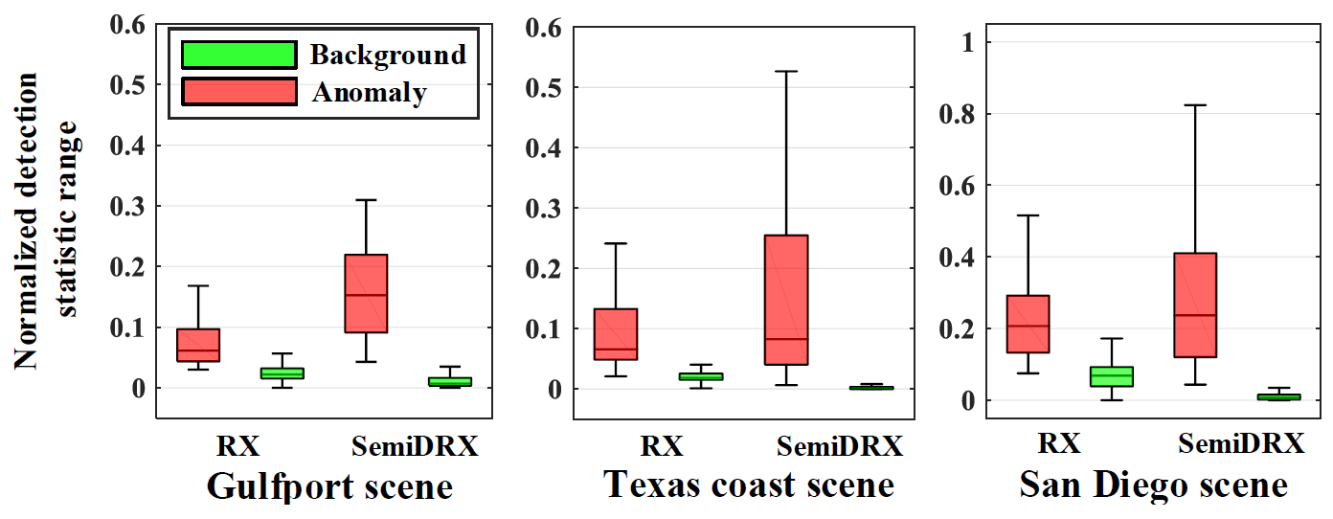
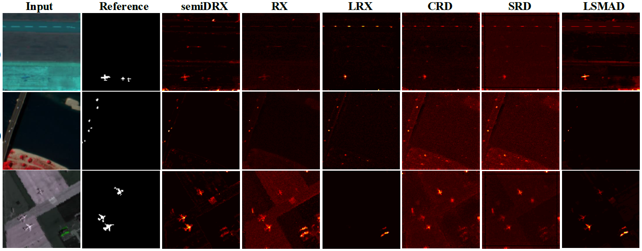
Experimentation
Anomaly-background separability maps of the RX and semiDRX
Detection maps
Source - https://ieeexplore.ieee.org/abstract/document/9323688
Source - https://ieeexplore.ieee.org/abstract/document/9323688
Notes:
So, in the experiments, 3 real HSIs with size 100 x 100 over different scenes were given as the inputs. The 3 rows include the Gulfport scene with 191 spectral bands, Texas coast scene with 204 bands, and San Diego scene with 189 bands are tested in the experiment.
The analysis was done with the anomaly-background separability in HSI before and after the application. From the Anomaly-background separability maps, the red and green boxes represent the distribution range of the anomalous and background pixels, respectively. The distance between the green box’s upper bound and the red box’s lower bound indicates their separation. In each subfigure, the first two columns and the last two columns refer to the anomaly-background separability of Coarse and refined detection results, respectively.
The height of each green box of the Semi Dual Reed-Xiaoli - the semiDRX model is smaller than that of RX model, indicating that the network of semiDRX model can homogenize the HSI’s background. Meanwhile, the separability of semiDRX model is also higher than that of RX, which means the network of semiDRX enhances the separability between the anomaly and background in HSI.
From the detection pictures, the semiDRX method not only locates the anomalies, but also retains the structural information of the anomalies. It can also fully detect small abnormal targets. Furthermore, when compared with other methods, semiDRX finds more evident anomalies with less background. But conversely, when comparing with other models, the discrimination between background and anomalies of the RX is poor; the LRX and LSMAD have the possibility of missing anomalies and the anomalies detected by LRX, CRD and SRD are all incomplete.

Slide 11
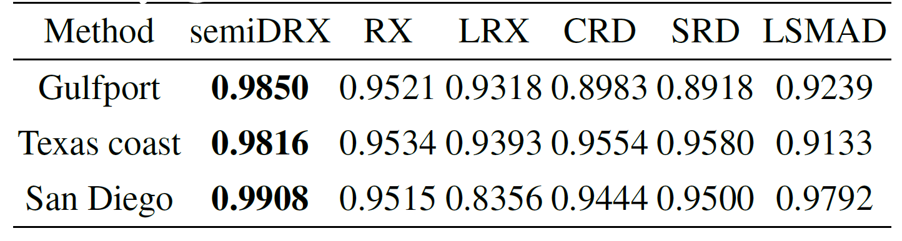
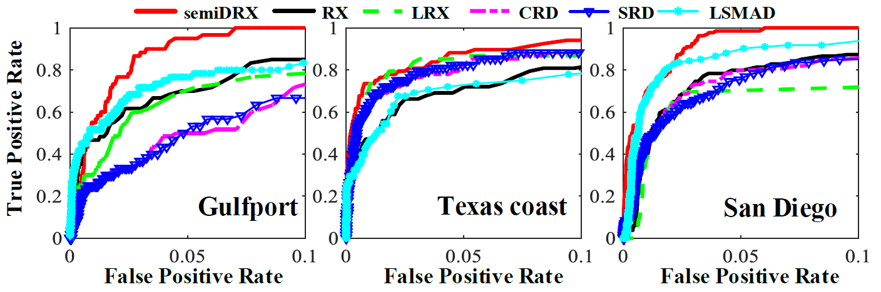
Conclusions
AUC Values on the 3 Datasets
Source - https://ieeexplore.ieee.org/abstract/document/9323688
ROC curves for comparison
Source - https://ieeexplore.ieee.org/abstract/document/9323688
Notes:
So, to compare and conclude the results, there are 5 commonly used anomaly detection methods that are compared to evaluate the Semi Dual Reed-Xiaoli model. So it is compared with the Reed-Xiaoli – the RX model, the Local Reed-Xiaoli – the LRX Model, the Collaborative Presentation Detector – the CRD Model, the Sparse Representation Detector – the SRD model, AND the Low-Rank And Sparse Matrix Decomposition – the LSMAD Model.
From the Receiver Operating Characteristics graph, the ROC graph, we can see that the ROC curves of semiDRX, which is in red colour, are higher than others from 0 to 0.1. And the Area under ROC values, the AUC value tables show consistencies with the visual ROC curves and detection maps. Hence, this indicates that the semiDRX method can generate excellent detection performance.
So as per my personal endeavor, the semiDRX method with semi-supervised GAN, innovatively learns a discriminative reconstruction of the background homogenization and anomaly saliency.
Furthermore, the employment of dual RX further improves the ability of the method to detect anomalies. The experimental analysis and results demonstrate that the semiDRX
method has superior competitiveness compared with other state-of-the-art Hyperspectral Anomaly Detection methods.

Slide 12
References
[1] A. F. Goetz, G. Vane, J. E. Solomon, and B. N. Rock, “Imaging spectrometry for earth remote sensing,” Science, vol. 228, no. 4704, pp. 1147–1153, 1985.
[2] I. S. Reed and X. Yu, “Adaptive multiple-band cfar detection of an optical pattern with unknown spectral distribution,” IEEE Trans. Acoust. Speech Signal Process., vol. 38, no. 10, pp. 1760–1770, 1990.
[3] Y. Zhang, B. Du, L. Zhang, and S. Wang, “A low-rank and sparse matrix decomposition-based mahalanobis distance ethod for hyperspectral anomaly detection,” IEEE Trans. Geosci. Remote Sens., vol. 54, no. 3, pp. 1376–1389, 2015.
[4] I. Goodfellow, J. Pouget-Abadie, M. Mirza, B. Xu, D. Warde-Farley, S. Ozair, A. Courville, and Y. Bengio, “Generative dversarial nets,” in Proc. Adv. Neural Inf. Process. Syst., 2014, pp. 2672–2680.
[5] H. Vu, D. Ueta, K. Hashimoto, K. Maeno, S. Pranata, and S. Shen, “Anomaly detection with adversarial dual autoencoders,” arXiv preprint arXiv:1902.06924, 2019.

Slide 13
THANK YOU

